Slide 1
Library math.h
#include<math.h>
“math.h” header file supports all the mathematical related functions in C language.
Some function use in math.h : sin(x), cos(x), sqrt(x),pow(x,a), fabs(x),log(x),log10(x)…

Slide 2
Description
sqrt(x) : returns the square root of x.
sqrt(x)= √x
pow(x,a) : returns x raised to the power of a.
pow(x,a)= x ^a
log(x) : returns the natural logarithm (base-e logarithm) of x. log(x)= log_{e}x (e=2.71…)
fabs(x) : returns the absolute value of x.
fabs(x)=|x|

Slide 3
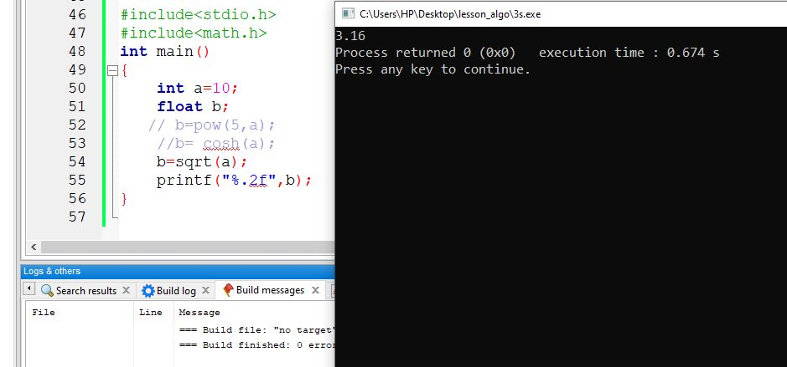
Example

Slide 4
Reference
https://www.geeksforgeeks.org/c-library-math-h-functions/
https://www.tutorialspoint.com/c_standard_library/math_h.htm
…

Slide 5
Exercise
1. Write a C by using math.h to find
Absolute value of -89
a = 2^6
b = base 10 logarithm of 100
2. Write a C program to get input from user value of variable a,b,x by using math.h to calculate value of y
y= cos(√a * b^a +|x| + log(b) )

